Slide 1
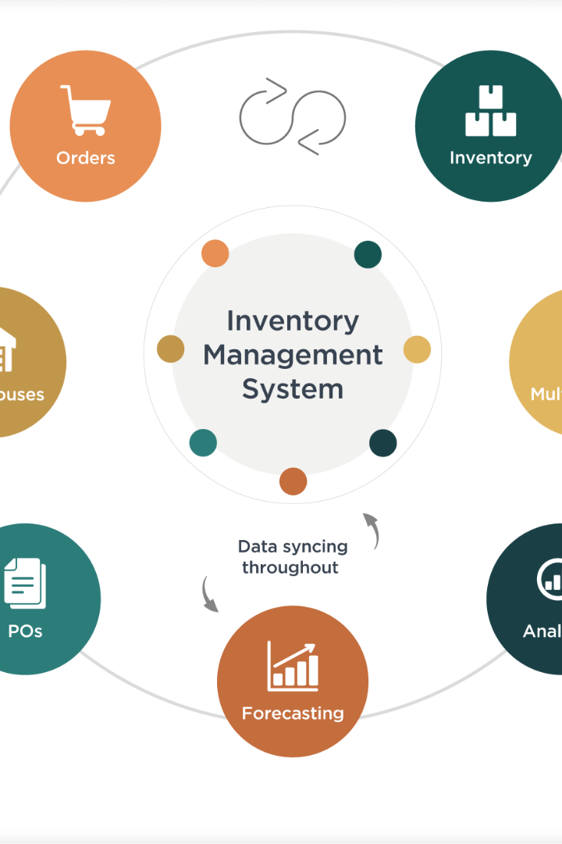
Inventory Management Database System
Group- 18
Team Members:
Priyadarshini Karaddi
Riya Chaddha
Vikram Reddy
Advait Kulkarni

Slide 2

Project Overview:
The database system for grocery stores to efficiently manage inventory. It centralizes stock data, tracks costs, and aims to reduce waste. The system supports better stock control and helps maintain optimal inventory levels. It's designed to improve store operations and performance. The goal is to streamline supply chain processes and increase customer satisfaction.

Slide 3
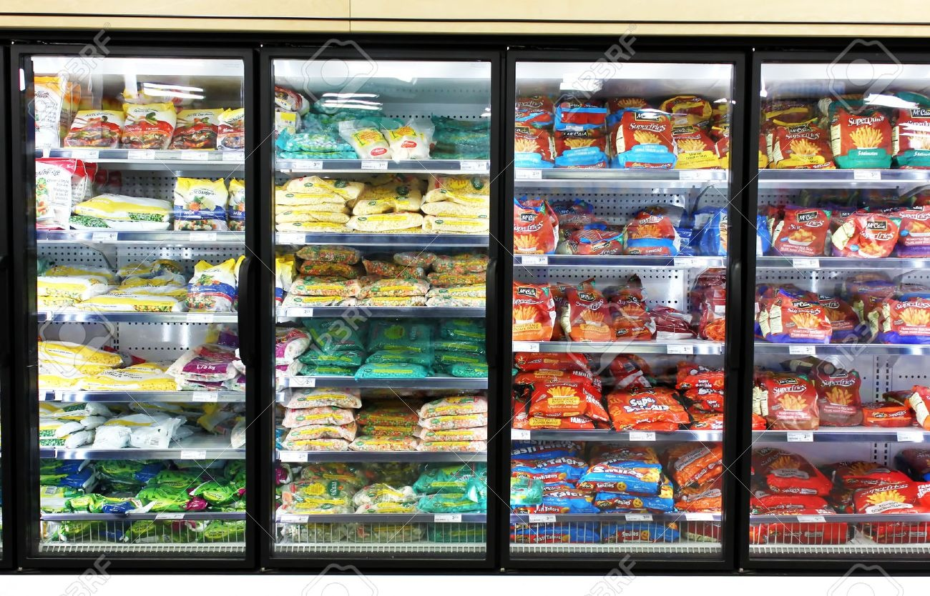

Design
Our database is intricately designed to track and adapt inventory in real-time, aligned with seasonal consumption patterns, ensuring that supply always meets demand. We've streamlined our database to support a rapid product lifecycle from onboarding to delivery through meticulously planned inventory workflows.
By analyzing inventory turnover rates, our system is calibrated to maintain optimal product quantities, thereby minimizing carrying costs and enhancing profitability.
The system's design now includes tightened batch-to-inventory associations, supporting accurate tracking and recall processes for products, critical for quality assurance.

Slide 4

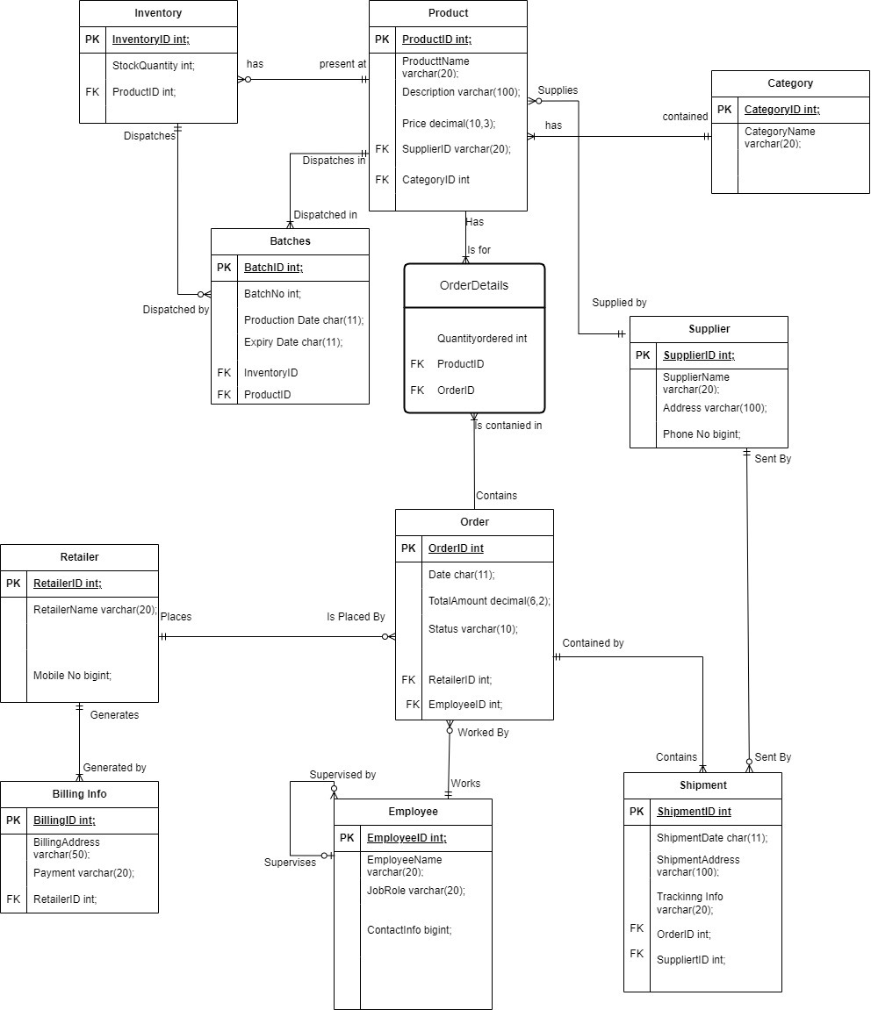
ER Diagram

Slide 5


Functions
GetTotalQuantityAvailable
ConcatenateProductNameAndDescription

Slide 6
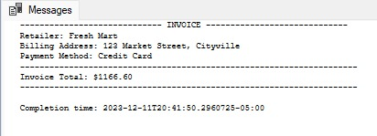


Stored Procedure
GenerateRetailerInvoice
GetProductsByCategory
GetEmployeeOrdersWithEmployeeName

Slide 7
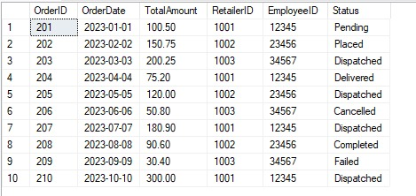

Triggers
trgAfterInsertShipment
NotifyManagerOnHighValueOrders

Slide 8
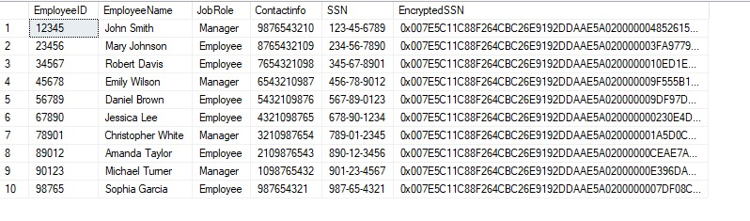
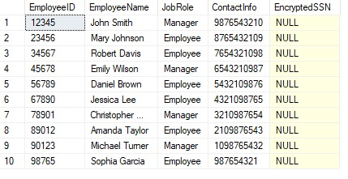
Encryption
Column Data Encyption
Encypted Table View

Slide 9
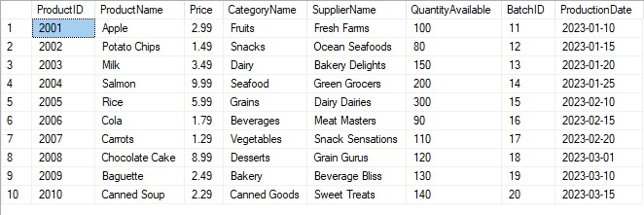
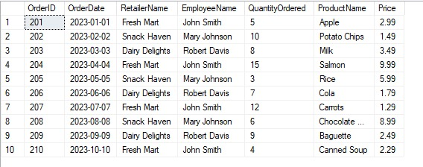
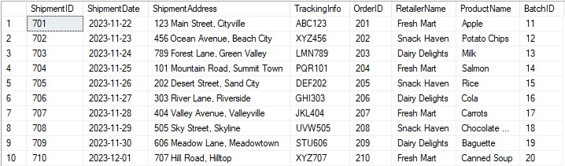
Views
ProductInventoryView
OrderDetailsView
ShipmentDetailsView

Slide 10
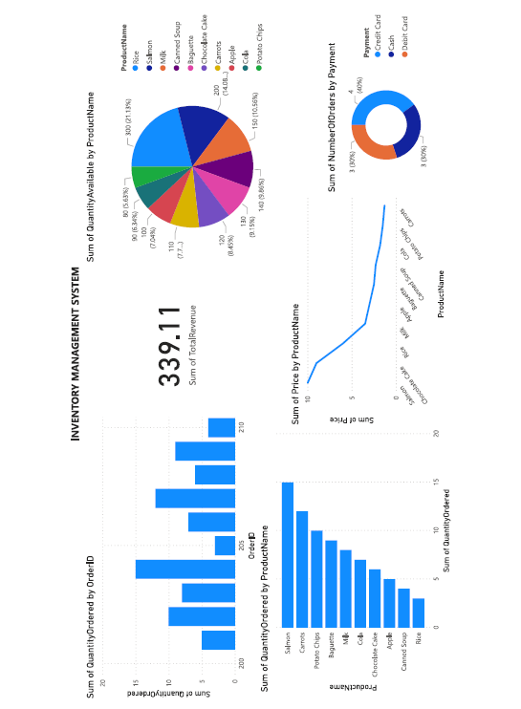
Power BI Visualizations

Slide 11
Thank You!

